Slide 1
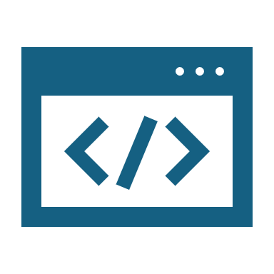
DevOps Full Pipeline for Semi-Colon Project
Mostafa Abdallah Mostafa
Mostafa Hussein Kamal
Hassan Ahmed El Bahnasy
Ahmed Mohamed Atwa
Ahmed Wagdy Mohy

Slide 2
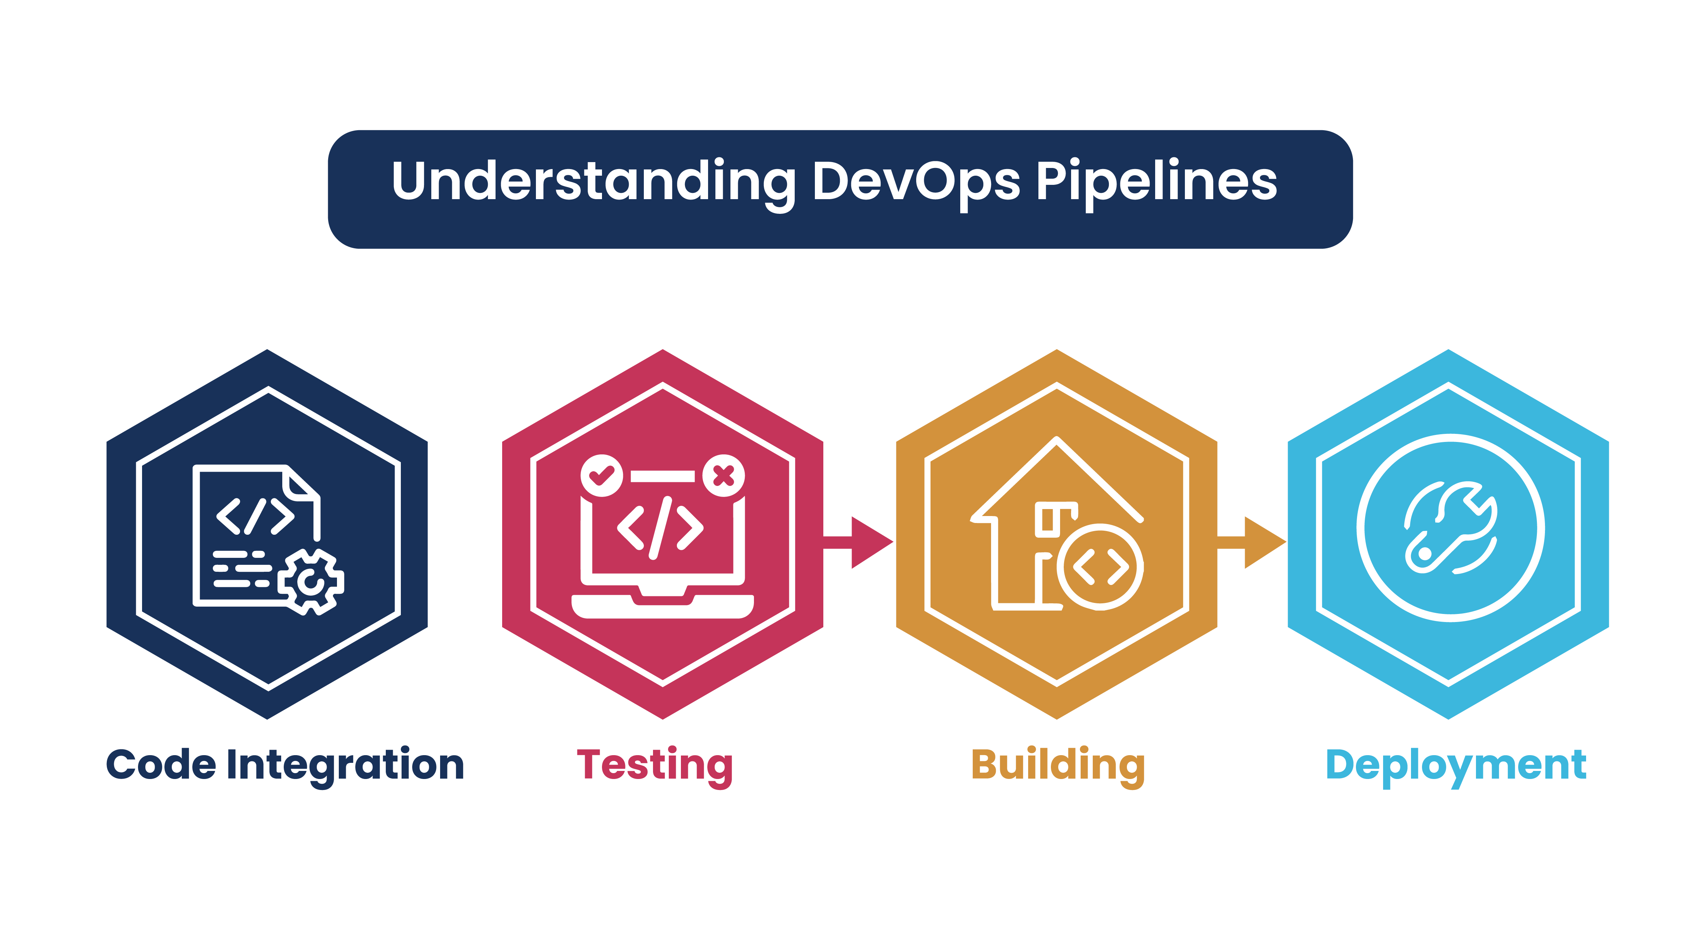
Overview
This presentation covers the complete CI/CD pipeline designed for the Semi-Colon project, incorporating modern DevOps tools such as Docker, Docker Compose, Terraform, Ansible, Jenkins, and Azure. The objective of this pipeline is to automate testing, building, deployment, and infrastructure provisioning.

Slide 3
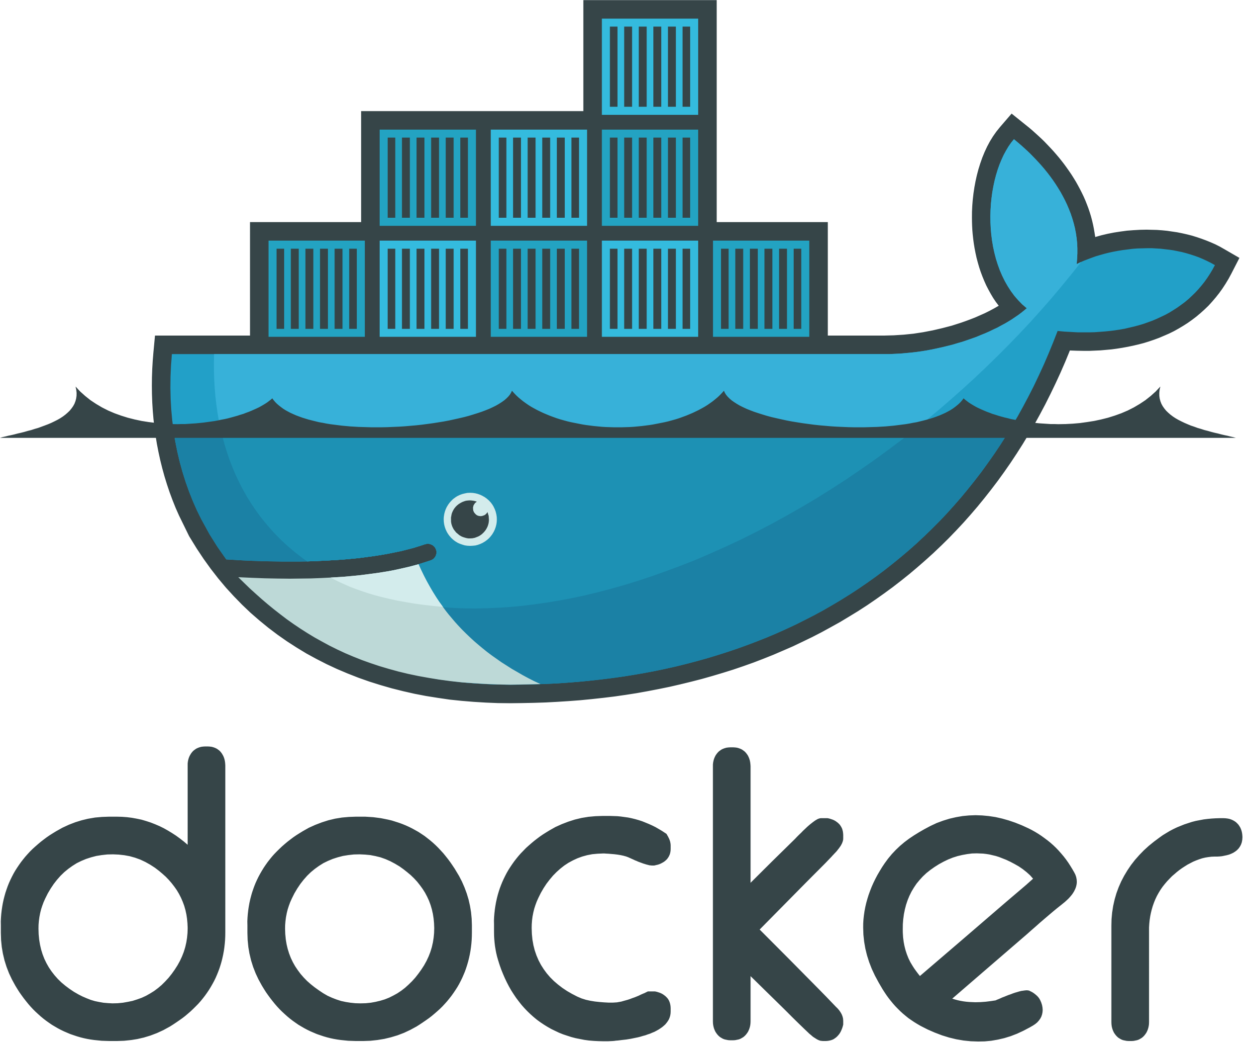

Slide 4
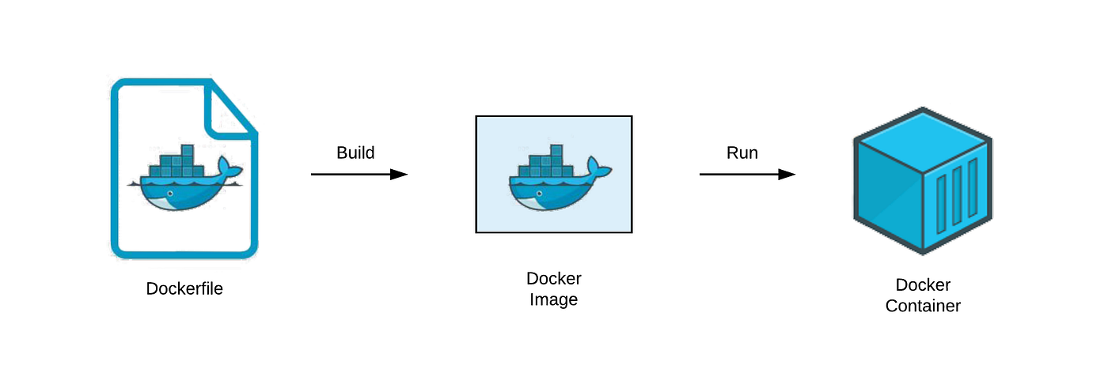
Dockerfile
Purpose:
To containerize the application, ensuring consistent environments across development, testing, and production.

Slide 5
Dockerfile
How:
Base Image: node:22-alpine was selected for its lightweight nature.
Stages:
Build Stage: Installs dependencies and compiles the project.
Production Stage: Strips away development dependencies, copies only the essential files, and sets up the production environment.
Healthcheck: Ensures that the service is running by checking the application's /health endpoint at regular intervals.

Slide 6
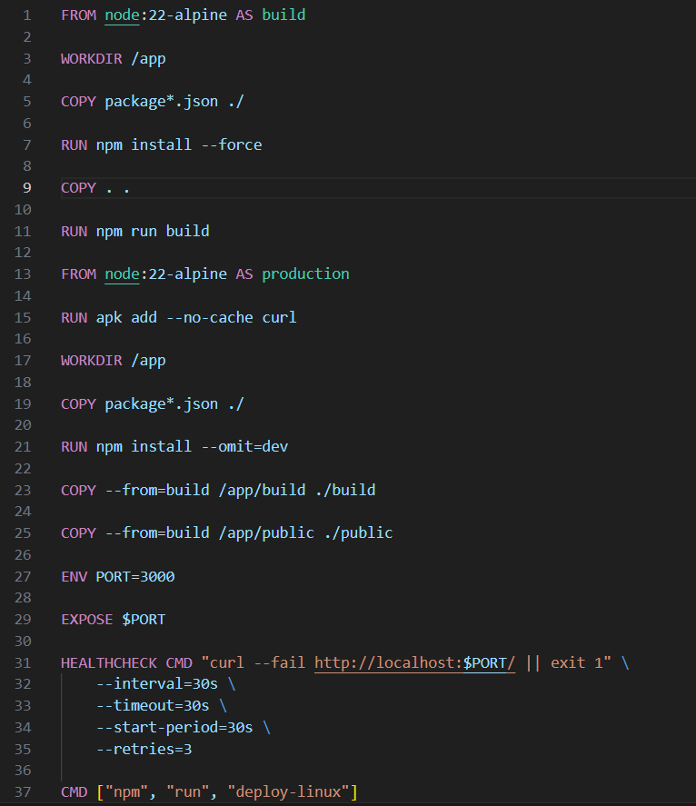
Dockerfile

Slide 7
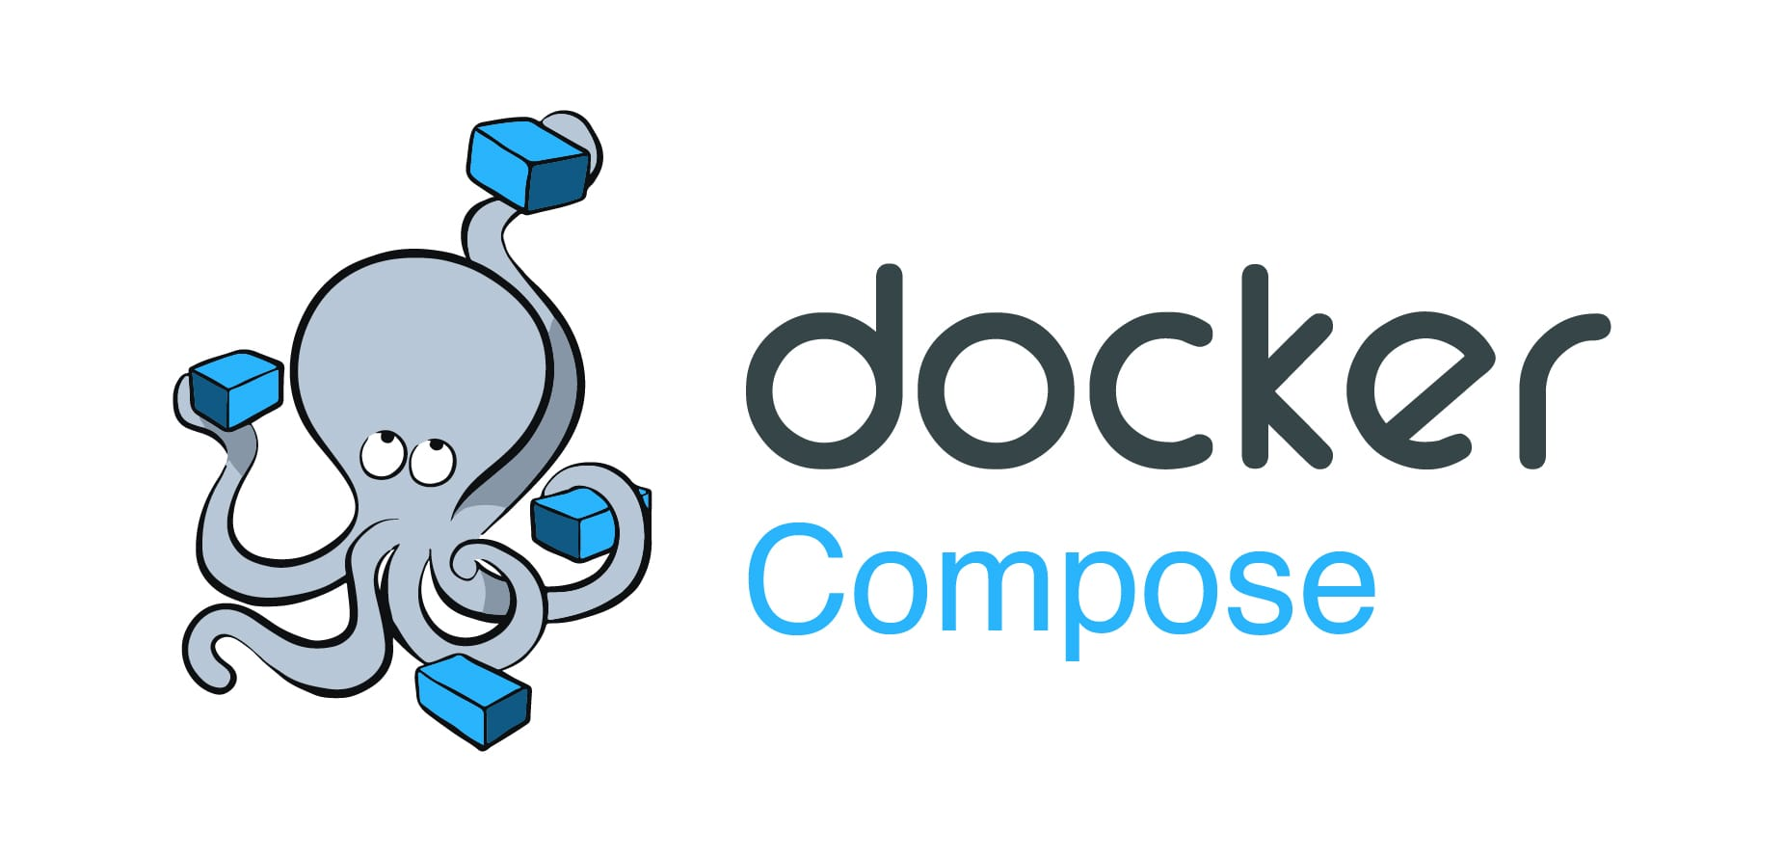
Docker Compose
Purpose:
To orchestrate multi-container applications in both testing and production environments.

Slide 8

Docker Compose
How:
Testing (docker-compose-testing.yml):
Defines a mongo service and a test service.
Tests the application using the specified database URL.
Production (docker-compose.yml):
Orchestrates MongoDB and the application’s backend.
Maps port 3000 to expose the application to external traffic.

Slide 9
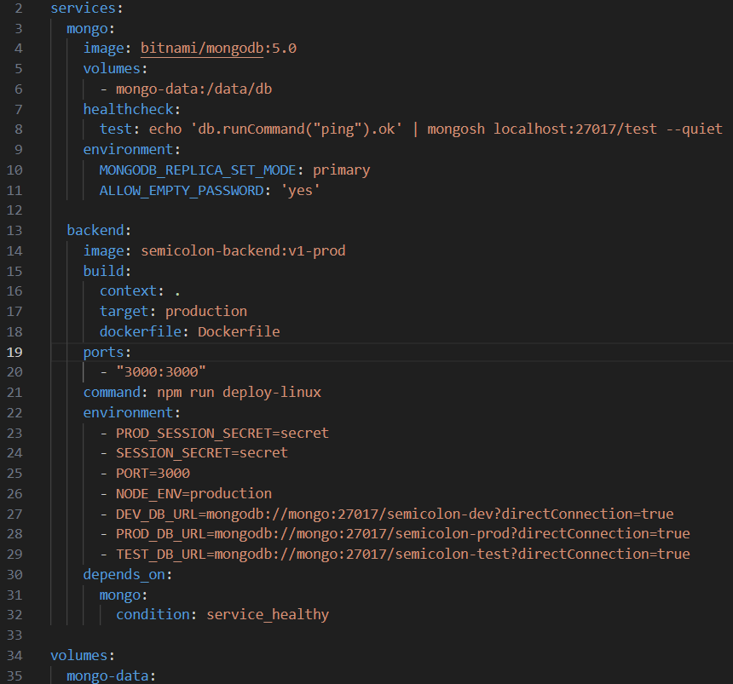
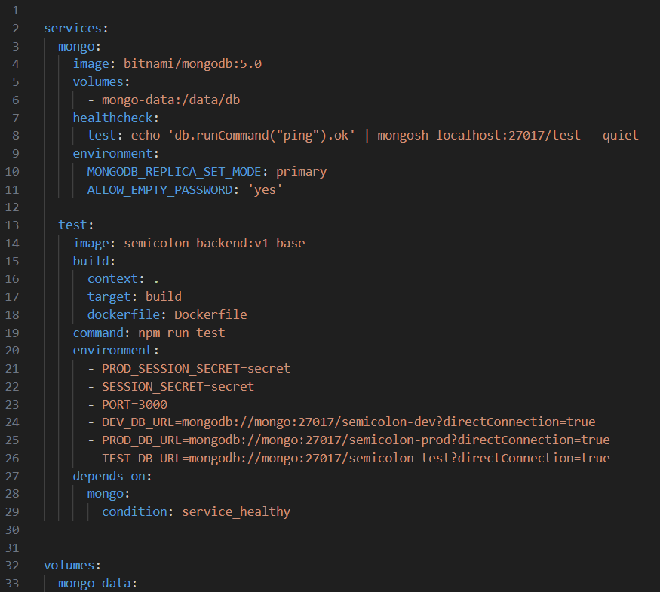
Docker Compose

Slide 10
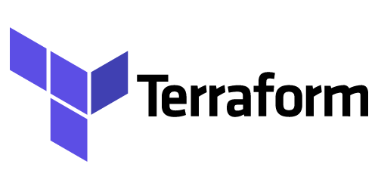

Slide 11
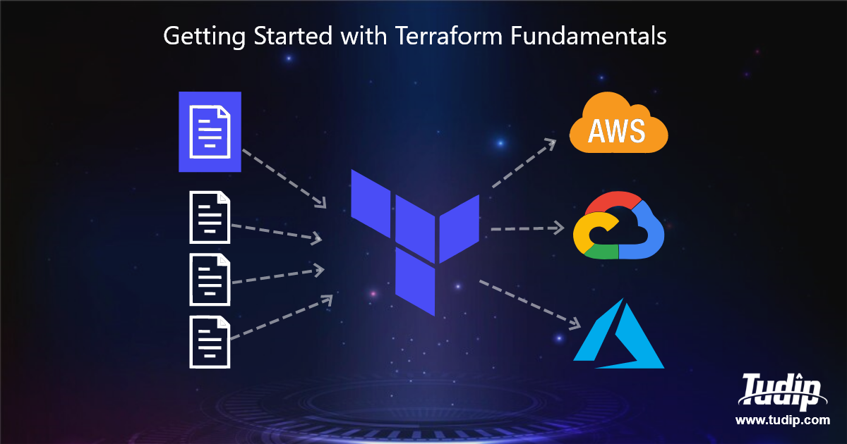
Infrastructure Provisioning with Terraform
Purpose:
To provision scalable infrastructure on Azure, including virtual machines, networking, and security groups.

Slide 12
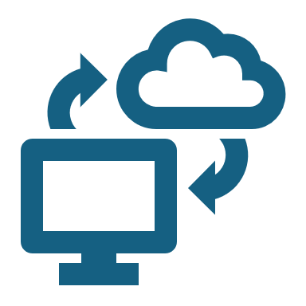
Infrastructure Provisioning with Terraform
How:
Virtual Network (VNet), Subnet, NSG:
Created to manage Azure networking and restrict inbound traffic based on predefined rules.
Public IP & Security:
Allows SSH access via port 22 and opens port 3000 for the application.
Virtual Machine:
Provisioned using an Ubuntu image and configured for SSH access and Docker installation.

Slide 13
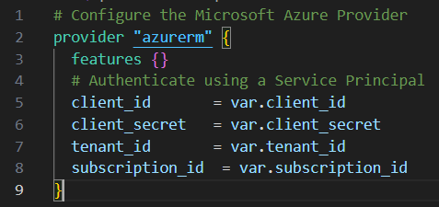
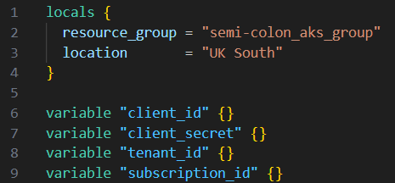
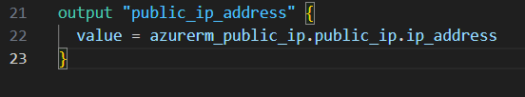
Providers, Variables, and outputs

Slide 14
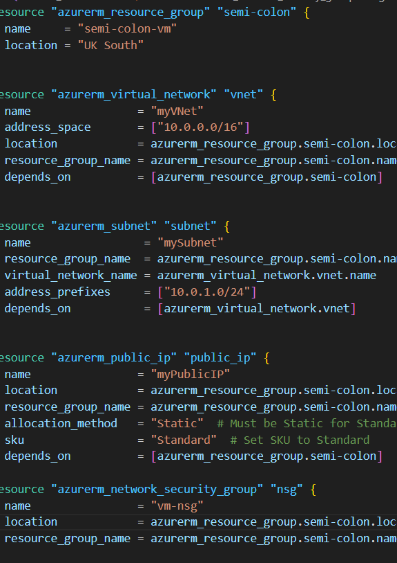
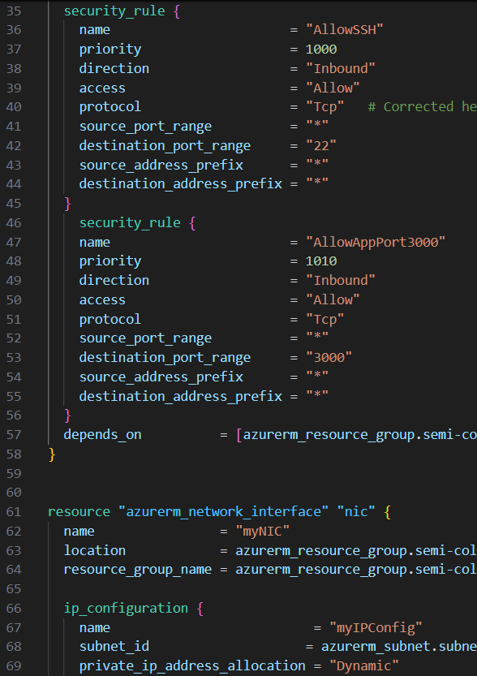
Virtual machine

Slide 15
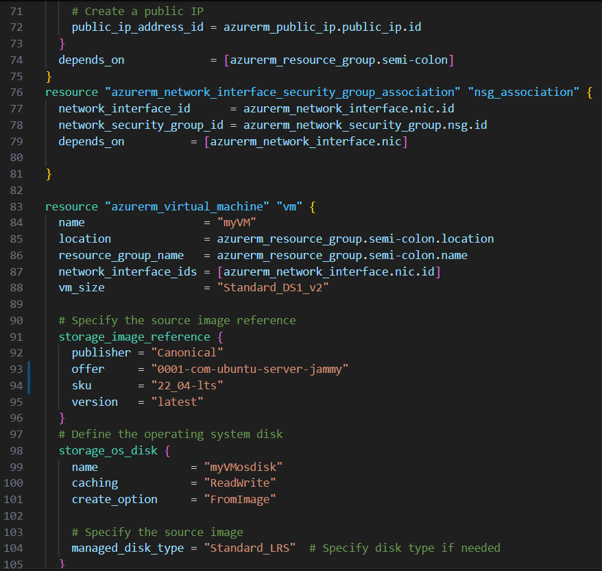
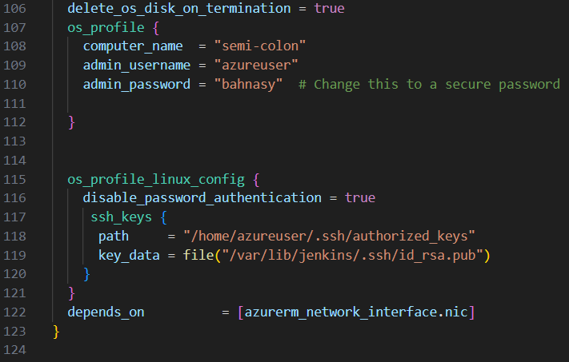
Virtual machine

Slide 16
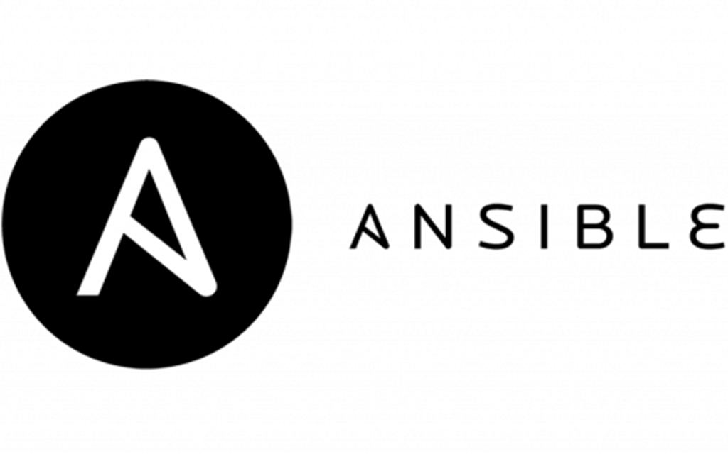

Slide 17
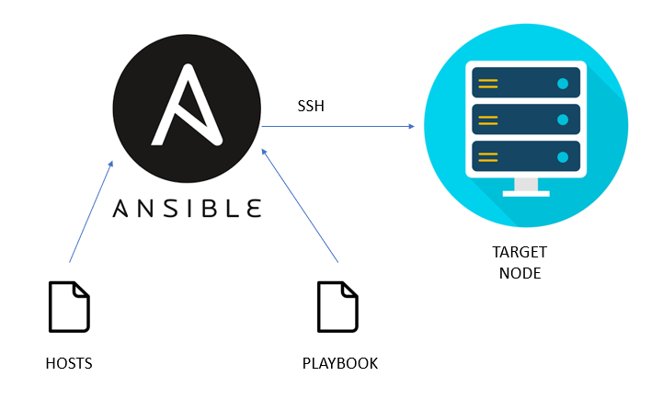
Configuration Management with Ansible
Purpose:
To configure the VM by installing Docker, Docker Compose, and deploying the application.

Slide 18

Configuration Management with Ansible
How:
Playbook tasks:
Updates system packages and installs Docker and Docker Compose.
Clones the GitHub repository and runs docker-compose up to deploy the application.

Slide 19
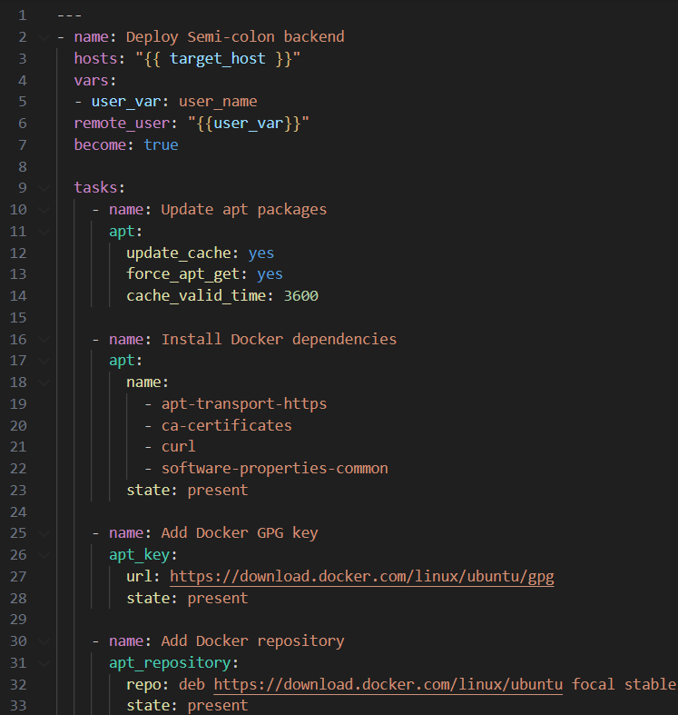
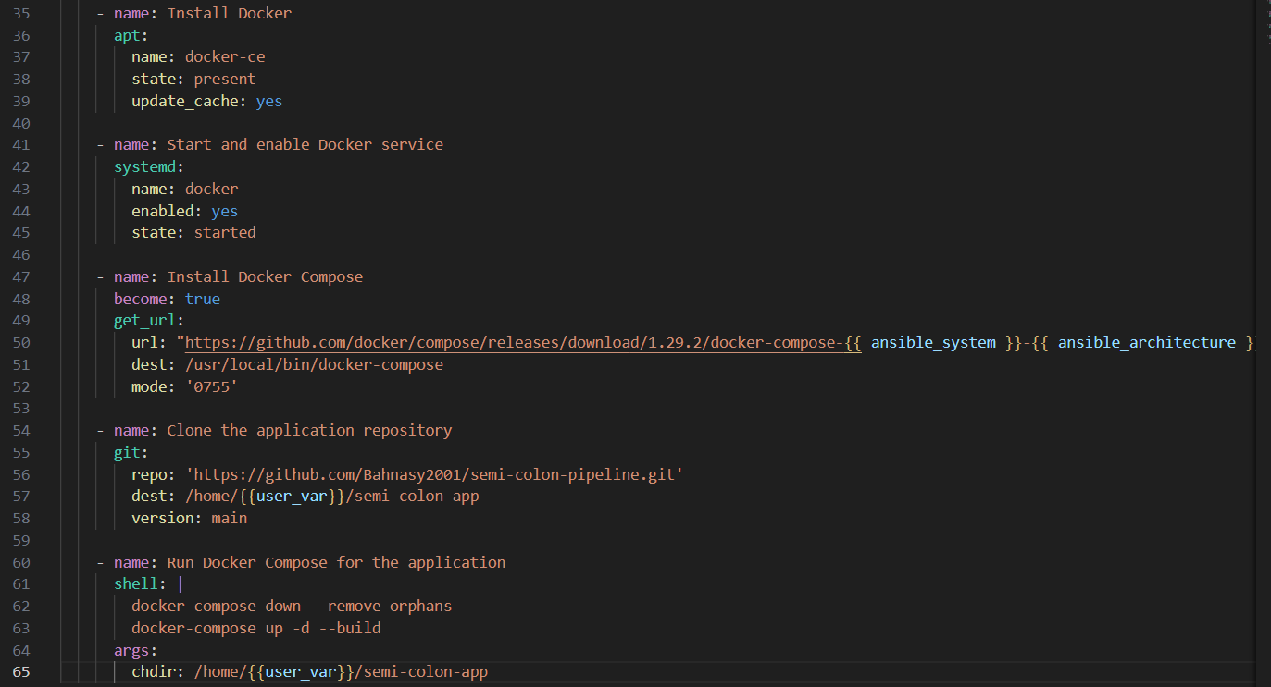
Playbook

Slide 20
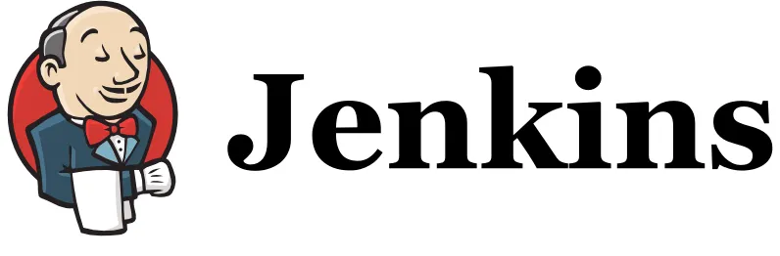

Slide 21
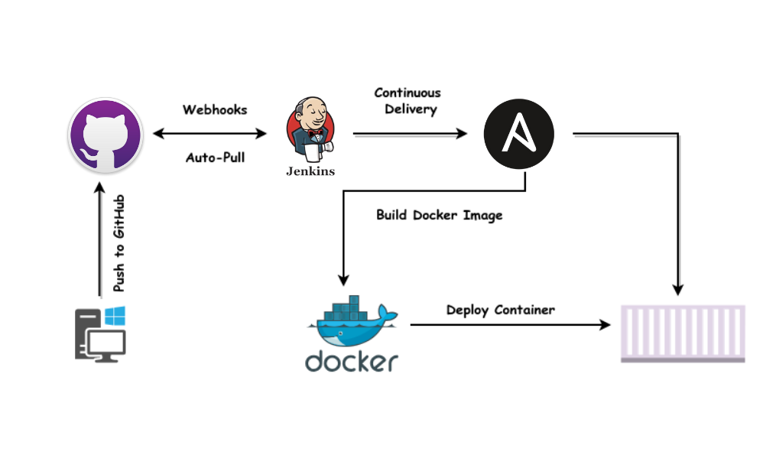
Jenkins CI/CD Pipeline
Purpose:
Automates the entire pipeline, from testing and building to deployment.

Slide 22
Jenkins CI/CD Pipeline
How:
Stages:
Preparation: Jenkins clones the GitHub repo triggered by a webhook via ngrok.
Test: Runs the docker-compose-testing.yml to ensure that all services work together before building.
Build: Builds the Docker image and pushes it to DockerHub with a version tag corresponding to the Jenkins build number.
Infrastructure: Uses Terraform to provision infrastructure.
Deployment: Runs the Ansible playbook to configure the provisioned infrastructure and deploy the application.
Notifications:
Sends success or failure messages to Slack for monitoring.

Slide 23
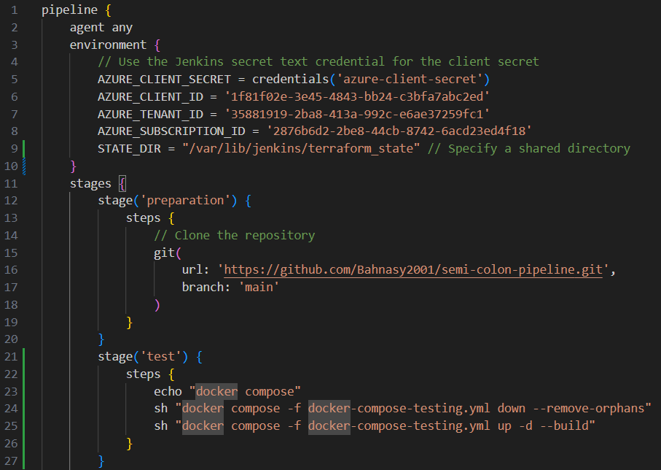
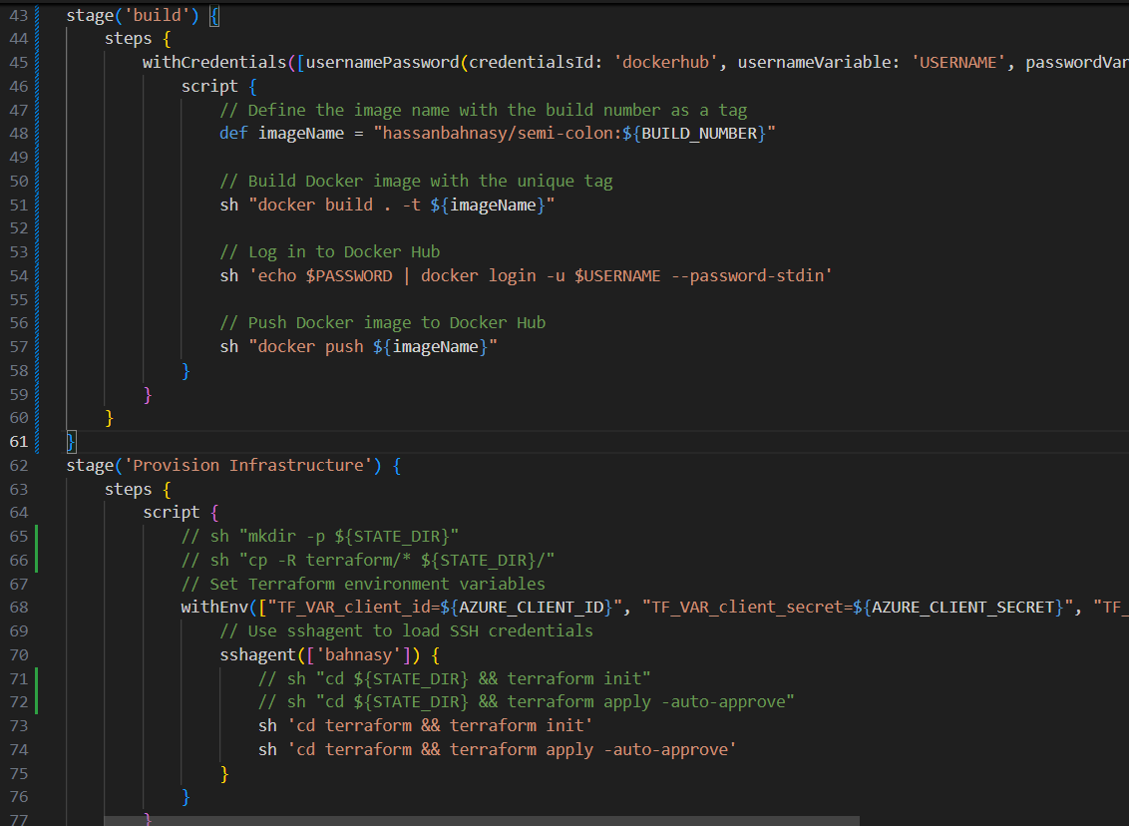
Jenkinsfile

Slide 24
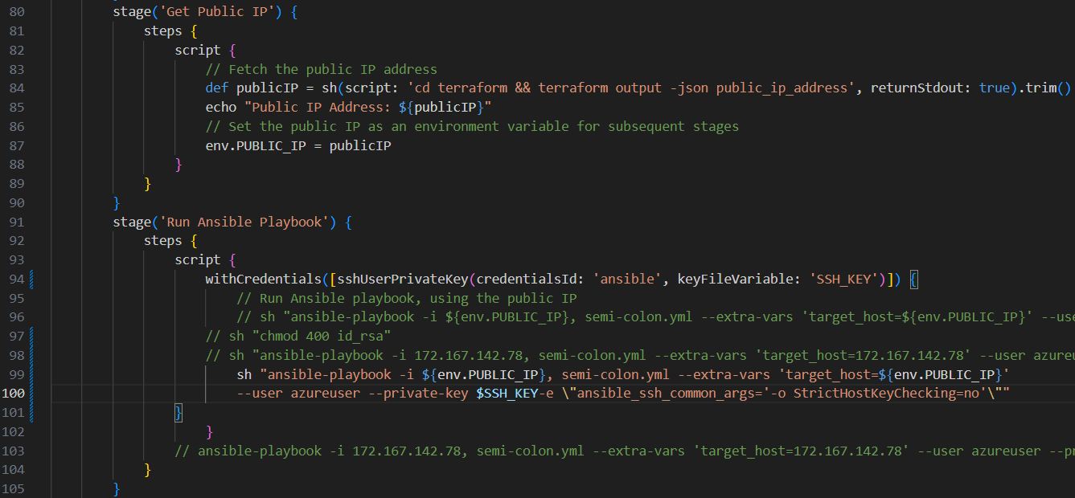
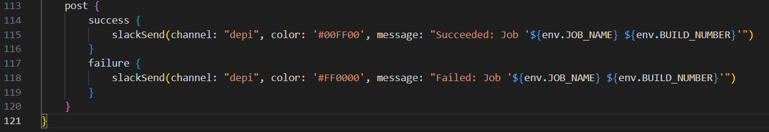
Jenkinsfile

Slide 25

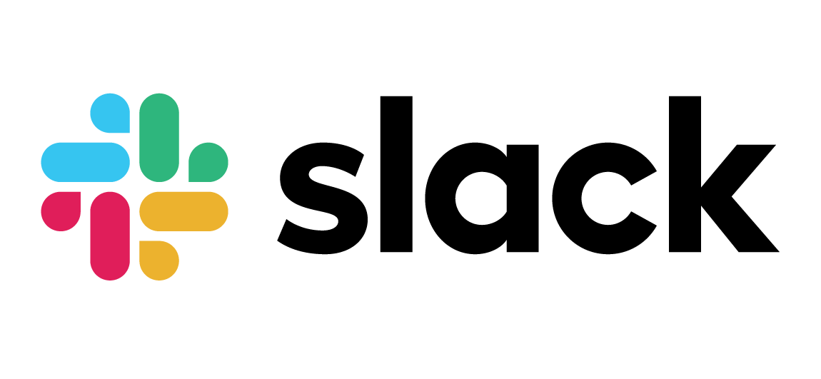

Slide 26
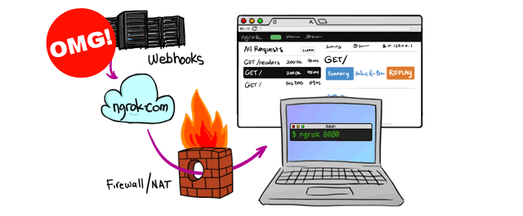
Webhook Integration and Slack Notifications
Purpose:
To automate the Jenkins pipeline on code changes and provide real-time feedback on pipeline status.

Slide 27
Webhook Integration and Slack Notifications
How:
GitHub Webhook (via ngrok):
Triggers the Jenkins job when a commit is pushed to the GitHub repository.
Slack Integration:
Jenkins sends success or failure notifications to a Slack channel at the end of the pipeline execution, keeping the team informed.

Slide 28
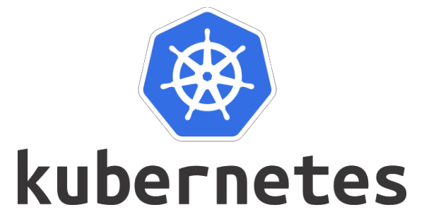

Slide 29
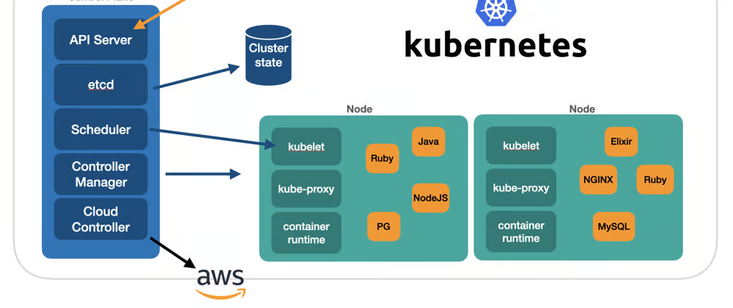
Testing with Kubernetes
Purpose:
Provides container orchestration for deploying, scaling, and managing applications and services across a cluster of nodes.

Slide 30
Testing with Kubernetes
How:
Components:
ConfigMap (app-configmap):
Stores non-sensitive configuration data like environment variables required by the application (e.g., PORT, MongoDB URLs). These values are dynamically loaded by the application at runtime.
Deployment (app-deployment):
Defines how the backend application is deployed and managed. It uses a RollingUpdate strategy to ensure zero downtime during updates. The initContainer runs tests before the application container is started to verify functionality.
Ingress (app-ingress):
Manages routing and external access to the backend service through an HTTP route. It routes traffic from a hostname (semicolon-backend.com) to the appropriate service within the cluster.

Slide 31
Testing with Kubernetes
How:
Components:
Secret (app-secret):
Safeguards sensitive data like session secrets, storing them securely in base64 encoding. The application retrieves these secrets at runtime without hardcoding them in the configuration.
Service (app-service):
Provides a stable endpoint for the backend application, exposing it externally via a LoadBalancer. The service directs traffic on port 80 to the app's container port (3000).
MongoDB Deployment (db-deployment):
Manages the MongoDB database by running it inside a container, ensuring that data is persisted across reboots with mounted volumes.
MongoDB Service (db-service):
Provides an internal cluster IP address for other services to access the MongoDB database, ensuring communication stays within the Kubernetes cluster

Slide 32
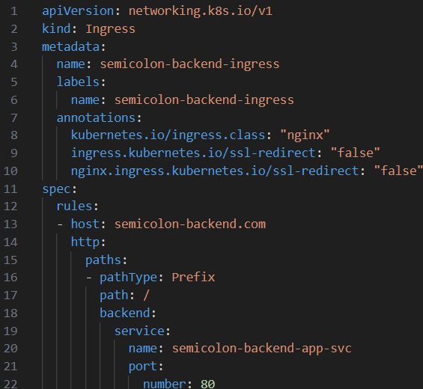
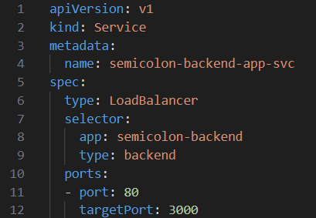
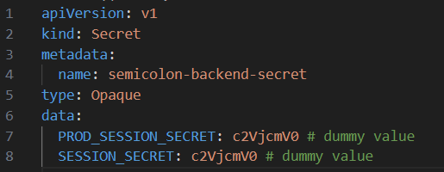
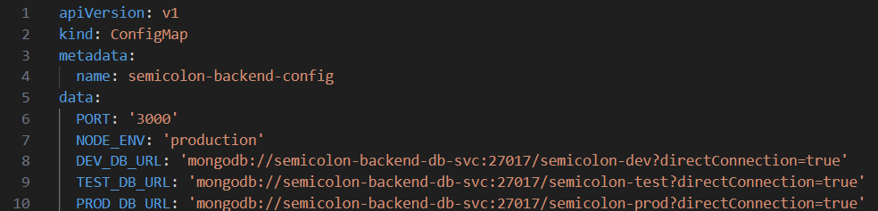
Application svc ingress secret configmap

Slide 33
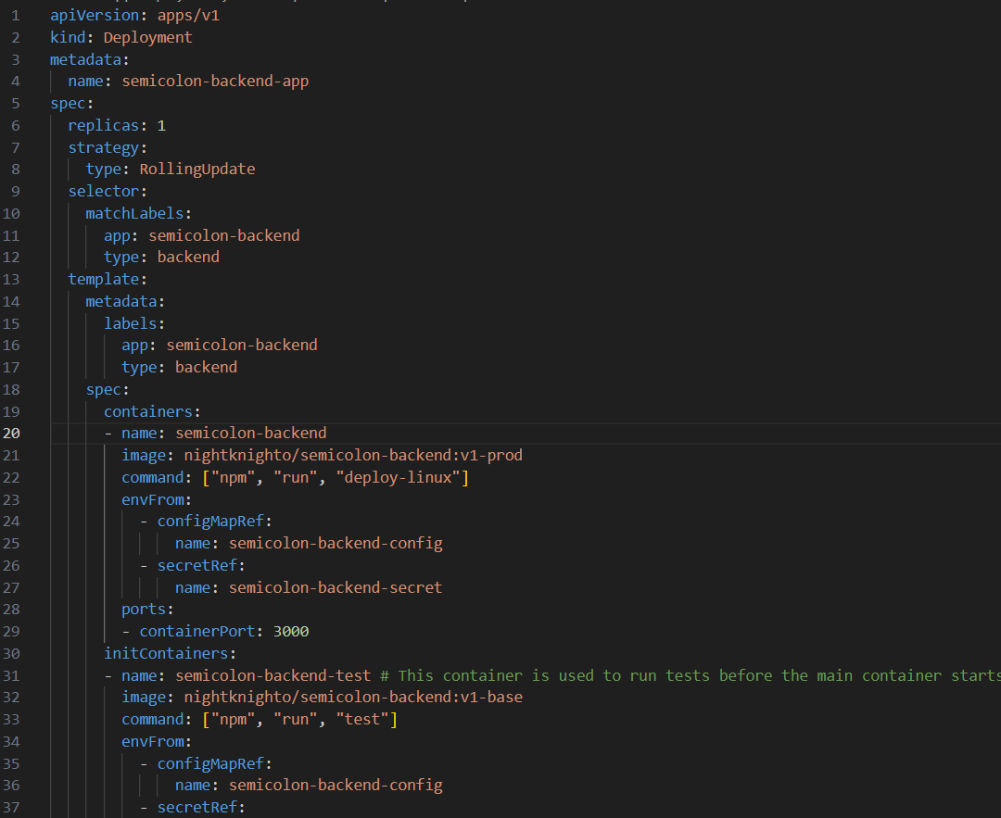
Application deployment

Slide 34
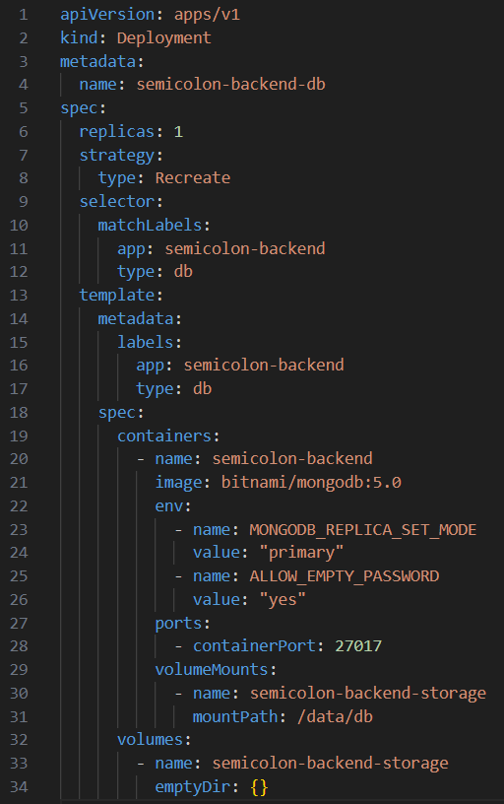
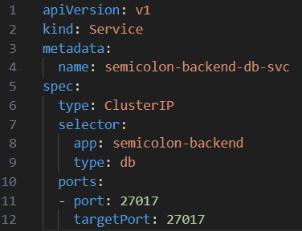
Database deployment svc

Slide 35


